Slide 1
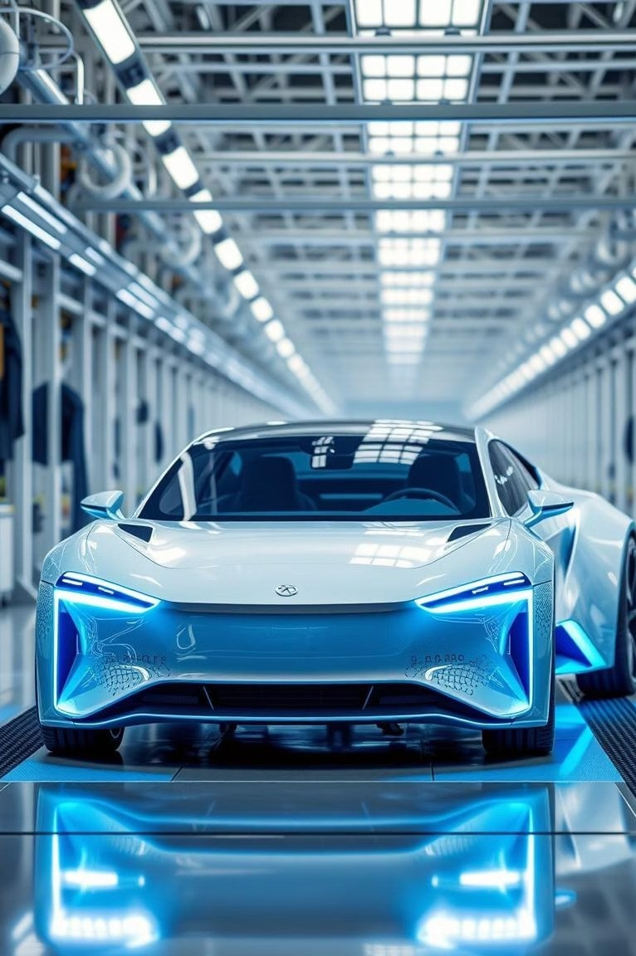

Research and In estment Recommendation in the
Automobile Sector-2025
A Data-Driven Analysis on Performance, Strategy, and Future Outlook

Slide 2





O er iew of Indian Automobile Sector
The Indian automobile industry is the world's third-largest by volume, valued at approximately ¹10.5 lakh crore (FY24), contributing significantly to India9s GDP.
PVs, CVs, 3Ws, 2Ws, and the fastest-growing EV segment.

Slide 3



Market Size and Segmentation (FY24)
Two-Wheelers Passenger Vehicles Commercial Vehicles Three-Wheelers & Others
Two-wheelers dominate the market with 76% share, while EVs show the highest growth at 36.2% YoY. Rural demand is also increasing.

Slide 4
Go ernment Initiati es and Policies
The Indian government is actively promoting the automobile sector through various schemes and policies.
FAME-II Scheme
¹10,000 crore subsidy for EV adoption, focusing on e-buses, e-2Ws, and e-3Ws.
PLI Scheme
¹25,938 Cr for Advanced Chemistry Cell (ACC) battery and Auto Component Manufacturing.
Scrappage Policy
Aims to boost demand for new vehicles and reduce emissions by scrapping older vehicles.
Tax Incenti es
GST reduction on EVs (12% to 5%) and additional income tax exemption under Section 80EEB.
Charging Infrastructure
Plans for 2,877 charging stations across India under Phase-II of FAME.

Slide 5
Financial Comparison (Q1 FY25)
Company | Revenue (¹ Cr) | Net Profit (¹ Cr) | Market Cap (¹ Cr) | P/E Ratio
Tata Motors | 1,02,000 | 7,800 | 3,54,000 | 16.8
Mahindra & Mahindra | 35,000 | 3,534 | 2,81,000 | 20.2
Maruti Suzuki | 35,300 | 2,970 | 3,75,000 | 28.5
Ashok Leyland | 11,200 | 582 | 64,000 | 17.5
Tata Motors leads in revenue and net profit, while Maruti Suzuki has the highest market capitalization.

Slide 6
Key Ratios and Metrics
Company | ROA (%) | P/S Ratio | Debt to Equity
Tata Motors | 4.8 | 0.65 | 0.85
Mahindra & Mahindra | 5.9 | 1.10 | 0.30
Maruti Suzuki | 6.3 | 2.40 | 0.10
Ashok Leyland | 5.2 | 0.70 | 0.48
Maruti Suzuki demonstrates asset-light operations with low debt, while Tata Motors has higher leverage due to JLR and EV capex.

Slide 7
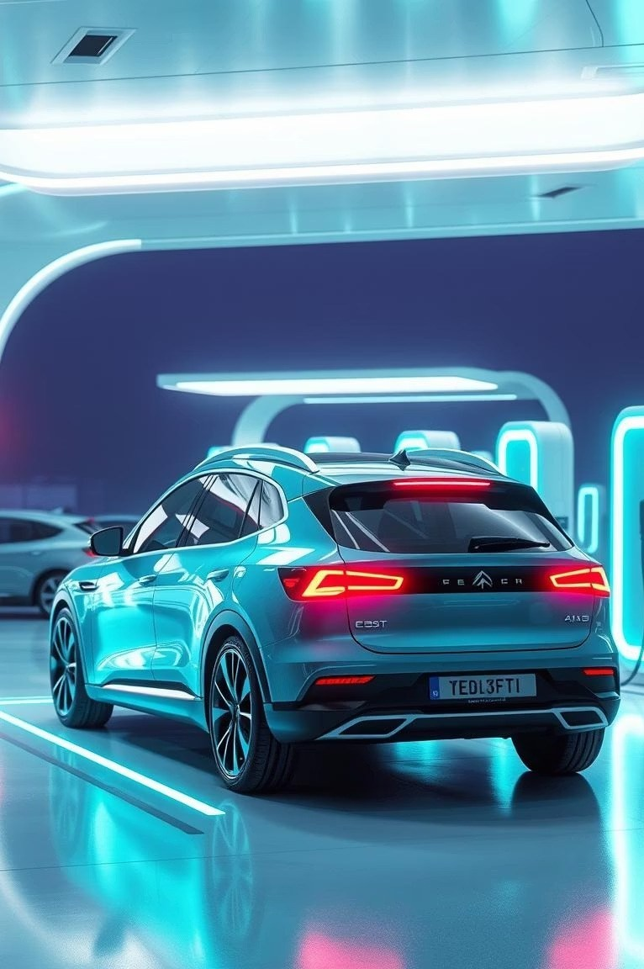
EV Strategy Comparison
Tata Motors
Mahindra
Maruti Suzuki
Ashok Leyland
Nexon EV, Tiago EV, Curvv EV, Avinya (future). Leads in EV execution.
XUV400, Born
Electric Platform. Catching up with Born EV.
Launching eVX in 2025, focus on hybrids.
Electric buses, LCVs, battery- swapping tech.

Slide 8
Financial Analysis 3 Ashok Leyland
Performance (Q1 FY25)
Revenue: ¹9,517 crore
Net Profit: ¹576 crore (± 25% YoY) Operating Margin: ~8.6%
Market Cap: ¹56,000+ crore
Strategy C Challenges
EV Strategy: Subsidiary Switch Mobility focuses on EV buses and LCVs.
Future Plans: Launch new electric buses, double EV capacity by 2026, export expansion.
Challenges: High competition, rising input costs, supply chain disruptions.

Slide 9
Financial Analysis 3 Toyota Kirloskar
Performance (FY24)
Strategy C Risks
Ownership: Joint venture of Toyota Japan and Kirloskar Group.
Revenue: Estimated ¹49,600 crore Net Profit: ¹2,370 crore
Market Position: 4th largest PV manufacturer in India.
EV Strategy: Focus on self-charging hybrids, localized battery production, Flex Fuel Hybrid in 2025.
Future Outlook: Increase localization to 75%, collaborate with Suzuki for small EVs, export base for hybrids.
Risks: High pricing of hybrid variants, market shift to pure EVs.

Slide 10
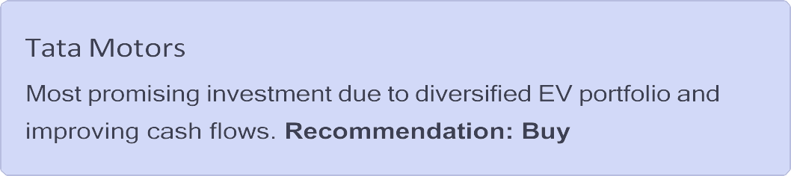
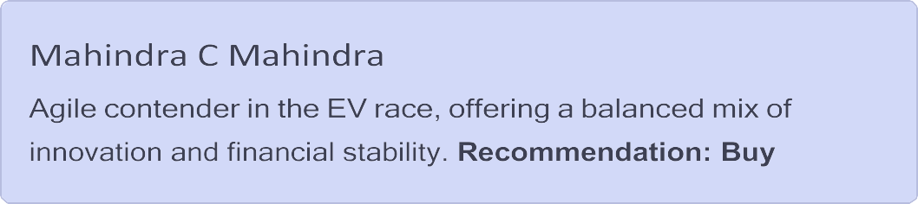
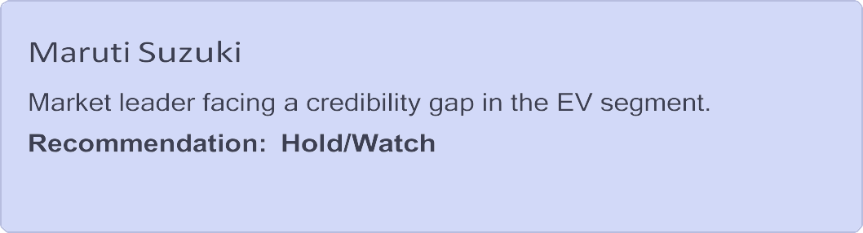
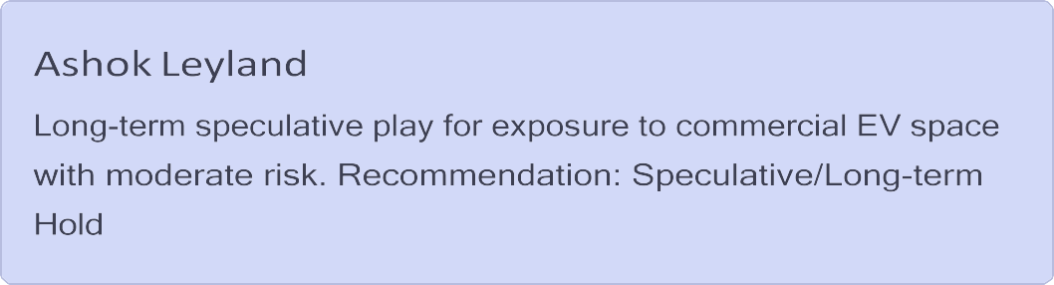
Conclusion C Recommendation Summary
The Indian automobile industry is entering a high-growth, EV-centric phase.

